Slide 1
2026-2027 course registration
Cypress Creek High School
Incoming 9th Grade
Parent University

Slide 2




WELCOME TO COYOTE NATION!
WE ARE READY FOR YOU,
class of 2030!!!
Notes:
Half-way through the year!
Are you ready for your promotion to high school?

Slide 3
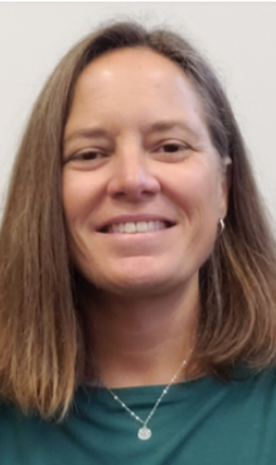
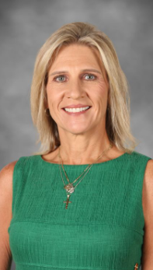
We are here to help you succeed!
Meet your 2026-2027 Coyote Team!
Carin Hetzler-Nettles, Principal
Kristine Fewox, 9th Grade Assistant Principal
TBD, 9th Grade School Counselor

Slide 4
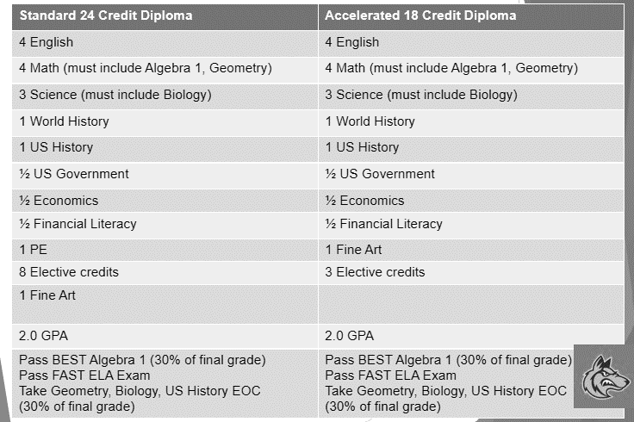
Overview of high school graduation requirements

Slide 5
Course card classroom visitation for 2026-2027 school year
Recommended that students have a conversation with teachers and parent(s) prior to Mr. Messersmith visiting classes next week (Science).
Students will be inputting course requests electronically (online) through the myStudent portal with Mr. Messersmith and Ms. Jones during classroom visit. All course requests must be completed by the end of the day.
Monday, March 2nd: Mr. Oviedo Classes
Tuesday, March 3rd: Mr. Henningsen Classes
Wednesday, March 4th: Mrs. Meetze Classes
Thursday, March 5th: Mrs. Simonds Classes

Slide 6

Course selection guidelines
All students will have a 6 (six) period school day.
4 core classes (determined by pathways)
    English
    Math
    Science
    Social Studies
On course planner students select 6 (six) elective options by numbering 1-6 (NO “X” or “✔️”); **THE ONLY GUARANTEED ELECTIVES ARE SCHOOL CHOICE.
    #1 and #2 are priority electives
    #3, #4, #5, #6 are alternate electives
Recommended that students select HOPE (meets PE 1.0 credit requirement) and/or Fine Arts/CTE course in 9th grade
The Course Catalog & Curriculum videos are available on the CCHS website.

Slide 7

9TH GRADE COURSE PLANNING SHEET
EDUCATIONAL GOAL PATHWAYS
Traditional – After high school, this student's goal would be to enter the work force, join the military, or attend a technical or community college.
Advanced Scholars/AP Capstone Program – After high school, this student can attend a more competitive four-year university.
Course Planning Sheet is available on CCHS website:
REGISTRATION TAB>COURSE REGISTRATION INFORMATION>9TH GRADE COURSE PLANNING SHEET

Slide 8

NO SCHEDULE CHANGES WILL BE MADE…
PLEASE CHOOSE YOUR COURSES WISELY!

Slide 9

AP® courses are college-level courses offered in high school
Courses reflect what is taught in top introductory college courses
Students take AP Exams at the end of the course, measuring their mastery of college-level work
A score of 3 or higher on an AP Exam can typically earn students college credit and/or placement into advanced courses in college
Open enrollment

Slide 10
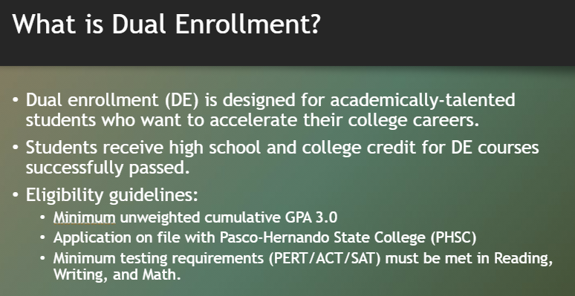
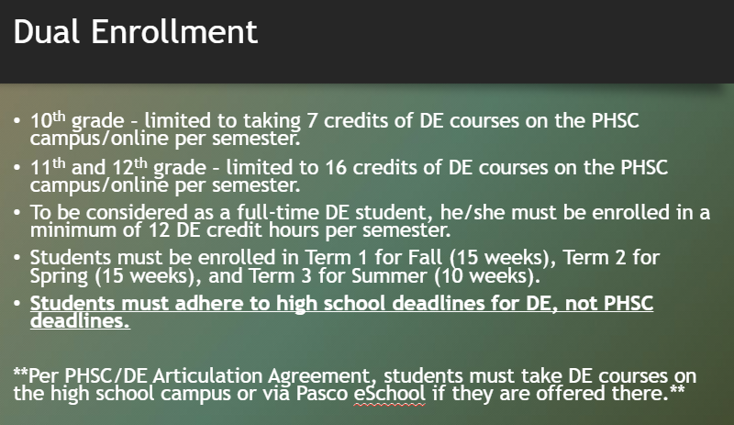

Slide 11
ADvanced coursework expectation agreement
Students and parents are required to complete the Advanced Coursework Expectation Agreement, if requesting an AP and or AICE course for the 2026-2027 SY.
    The MACH FORM is available via the CCHS website. REGISTRATION TAB
    Agreements will only be accepted electronically via the MACH form.
    Only one (1) Agreement is required, regardless of number of AP/AICE course requests.
    Deadline for completion is March 6, 2026; deadline to notify your current 8th grade school counselor if you decide NOT to take the course is Friday, March 6, 2026.
Guidelines are strictly adhered to and enforced.
AP classes may have summer assignments; make sure to check the CCHS website for updates.

Slide 12
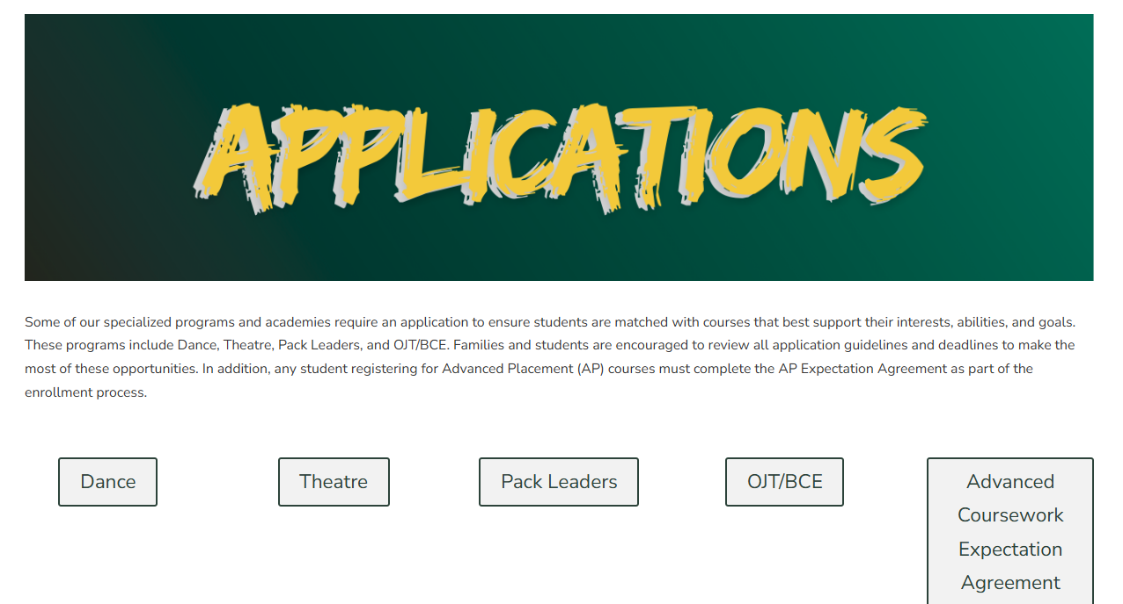
PROGRAM applications
Deadline for all applications is March 6, 2026.
Application(s) can be completed via the CCHS website under the Registration Tab.
Notes:
These are the only courses with applications that 9th graders are allowed to participate in during their freshman year.
Questions regarding the programs can be directed to appropriate teacher – can we add this link to website somewhere?

Slide 13
Dates to remember
Week of March 2nd – School Counselors will be visiting your science classroom for online registration; if you do not take a science class on the middle school campus, Ms. Jones will meet with your personally.
March 6, 2026 - deadline for Advance Coursework Expectation Agreement
March 6, 2026 - deadline for all Applications

Slide 14

Coyote Reminders
Behavioral Reminders
Wireless Device/Technology
Dress Code
Tardies
Positive Choices for a Positive Day- PBIS
Academic Reminders
No F’s
Missing assignments
GPA counts- ABCDF
Academic Lunch
After school tutoring
Notes:
JENA – tweak?

Slide 15

College & career Counselor
Karie Kwiat, 9th-12th
Office is located in the Media Center

Slide 16
Student Services support team
Allison Heck, School Nurse
Sara Franco, School Social Worker
Andrea Latimer-Chaney, School Psychologist

Slide 17

Save the Date!
Howlapalooza
July 30th, 2026

Slide 18

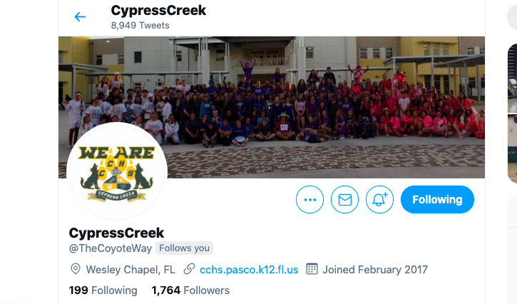

Stay connected
Cypress Creek High School Website - https://cchs.pasco.k12.fl.us/
Cypress Creek High School Twitter – @thecoyoteway
Cypress Creek High School Facebook – https://www.facebook.com/CypressCreekCoyotes/
Class of 2030 Page– COMING SOON!

Slide 19
Questions? sfewox@pasco.k12.fl.us

