Slide 1
Parent Informational Session: AP and Dual Enrollment
Kristina Padula, AP Coordinator
Cassie Adley, College and Career Specialist
Meredith Hagie-McHugh, Class of 2028 Counselor
Meredith Ward, Class of 2027 Counselor
Cassie Caminero, Class of 2026 Counselor
Kristen Leonard, Class of 2025/29 Counselor

Slide 2
Agenda
AP overview
Dual Enrollment

Slide 3

What We'll Cover
What are Advanced Placement® Courses?
The Benefits
AP Capstone
AP® Exams
What Is It Like to Take AP?
Next Steps: Help Your Child Make the Best Choices
Q & A
Notes:
Presenter reviews agenda with attendees, makes sure everyone can see the screen, hear, etc.
Presenter asks for questions prior to launching the next part of the presentation.

Slide 4

What Are Advanced Placement® Courses?

Slide 5
Advanced Placement ®: The Basics
AP® courses are college-level courses offered in high school
Courses reflect what is taught in top introductory college courses
Students take AP Exams at the end of the course, measuring their mastery of college-level work
A score of 3 or higher on an AP Exam can typically earn students college credit and/or placement into advanced courses in college
Open enrollment
Notes:
Presenter can add to this information with the following points:
Advanced Placement® is a program developed and overseen by the College Board, the not-for-profit organization that is responsible for the PSAT/NMSQT®, SAT®, and other programs and services in college readiness and college success that help more than seven million students each year prepare for a successful transition to college.

Slide 6
2025 - 2026 Cypress Creek High School’s AP® Courses
Math | Science | English | Social Studies | Electives
Pre-Calculus Calculus AB Calculus BC Statistics | Biology Environmental Chemistry Physics | Language Composition Literature | Human Geography World History United States History U.S. Government and Politics Macroeconomics Psychology Comparative Government | Capstone Research Capstone Seminar Computer Science Principles Computer Science A Art/Drawing Portfolio 2-D Art/Drawing Design AP Spanish
Keep in mind CCHS is still growing. As more students enroll our AP Program will grow too!
Notes:
Reiterate that not all courses fulfill the subject graduation requirement

Slide 7

AP®: The Benefits

Slide 8
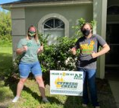

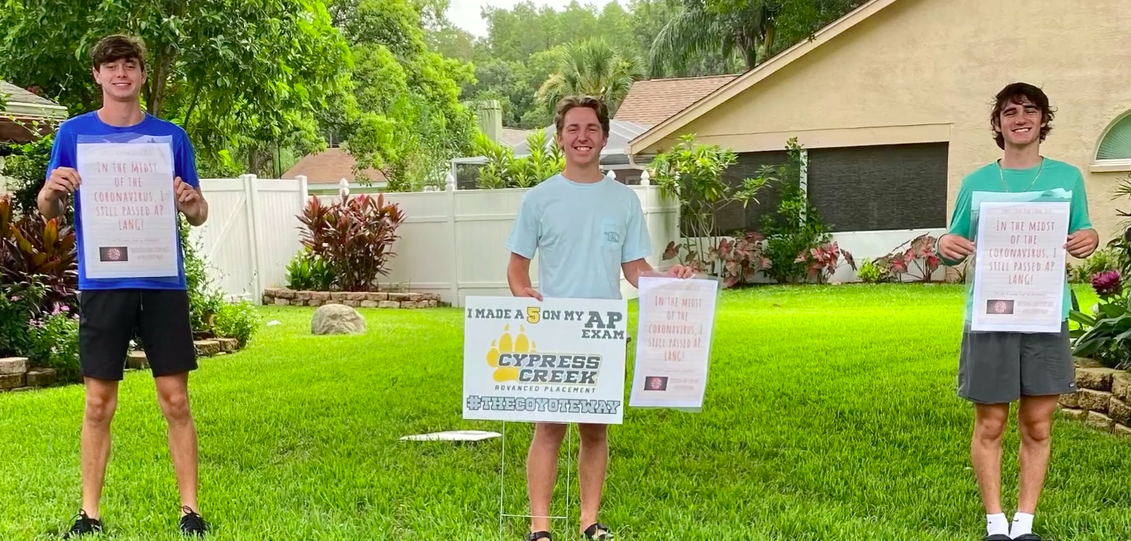
AP®: The Benefits
Students learn rigorous college-level content and skills
Taking AP is valued in the college admission process
AP courses are interesting and rewarding academic experiences
Opportunity to earn valuable credit (GPA) and placement in college
Does not impact your collegiate GPA.

Slide 9
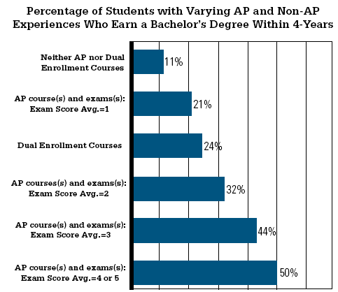
Students who scored a 2 or higher on an AP Exam were more likely than other students to earn a bachelor’s degree within 4 years.

Slide 10

AP® Expands Students’ Options
When students earn college credit through AP Exams, their options and opportunities expand:
Move to upper-level college courses sooner
Pursue a double major
Gain time to study and travel abroad

Slide 11
AP®: A More Engaging Learning Experience
AP courses challenge students to work and participate at a higher level:
Opportunities to explore topics in depth
More time in and out of the classroom required to complete assignments and projects
High expectations for critical thinking, analysis, synthesis, evidence, multiple perspectives, and clear written and verbal communications

Slide 12
AP Capstone

Slide 13

AP Capstone
An innovative program that helps you stand out the college admissions process by developing the critical skills needed to succeed in college and in your future career.
Two courses – AP Seminar and AP Research – allow students to
immerse themselves in topics that matter to them, while they develop the analytic, research, problem-solving, and communication skills that colleges seek in their applicants.

Slide 14
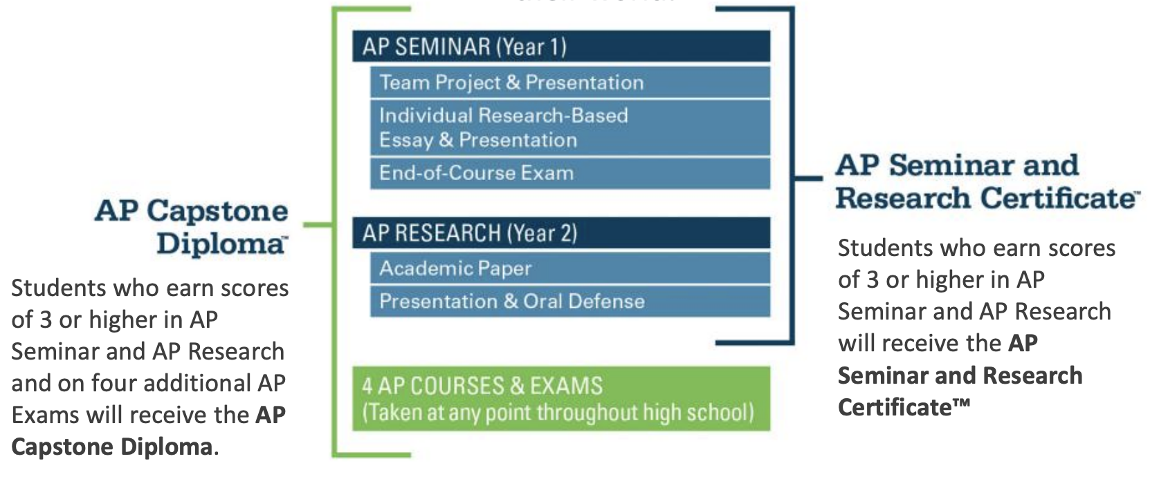
AP Capstone Diploma
This challenging program helps students deepen their passion for learning, gives them greater confidence in your academic skills, and a broader perspective on their world.

Slide 15

AP® Exams

Slide 16

AP® Exams
AP Exams are administered by schools worldwide on set dates in May each year.
Exams are typically 2–3 hours and include:
  Multiple-choice questions
  Free-response items such as essays, problem solving,
  document-based questions and oral response

Slide 17
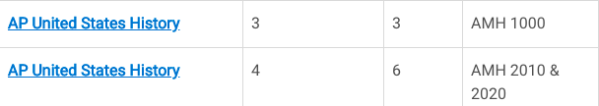
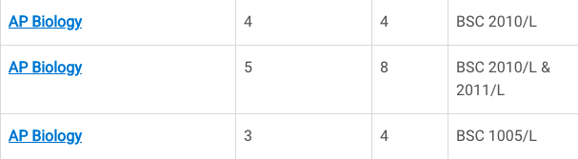
Credit and Placement Opportunities
Each college and university has its own policies regarding AP® credit and placement. The College Board offers information about AP credit at thousands of college and universities at www.collegeboard.org/apcreditpolicy.
Search by school name or alphabetically
Data for each school includes a direct link to that school’s Web page detailing AP credit and placement policies
A statement from the college or university about its AP policy
Examples: University of South Florida - Tampa

Slide 18

What is it like to take AP®?

Slide 19
Our School Offers Support for AP® Students
Cypress Creek High School Enrichment or Intervention Periods
Our school offers these resources and programs to support our AP students:
Peer Tutoring, Tuesdays in the Media Center from NHS Students
Coyote Core
AP Test Prep will full-length practice exam given in some subjects scheduled on Saturdays in April.

Slide 20
Next Steps: Help Your Child
Make the Best Choices

Slide 21
AP®: Start the Conversation
Help your child prepare to talk to a teacher or counselor about AP. Here are some questions to encourage your child to think about:
What AP course is right for me?
Before you talk to a teacher or counselor, think about what interests you:
Which courses do you enjoy most in school? In which subjects do you excel?
What college majors are you considering? What careers excite you?
Ask your counselor or teacher the following questions:
In which AP courses at our school am I likely to do well?
Are there other courses that can help me succeed in AP or prepare me for college and careers?
What steps do I need to take?
What is our school’s enrollment deadline?
May I speak with a student who has taken an AP course?
Are there study groups or people who can offer help if I need it?
What can I do next to help me prepare for AP?
Notes:
Presenter: Encourage families to talk openly and realistically with students about the time commitment, challenges, etc., without exaggerating the difficulties. Many students take multiple AP courses and thrive. Others find better success with one or two AP courses, depending on their other school, work and home commitments.

Slide 22
CCHS Information Sessions
Students will receive their course cards for the next school year in late January.
Current AP teachers will go into feeder courses to discuss the AP class they teach. This provides students the opportunity to ask questions.

Slide 23
CCHS Contact Information
Kristine Fewox
  Sfewox@pasco.k12.fl.us
  813-346-4400
  Assistant Principal over Advanced Placement
Cassie Adley
  Cadley@pasco.k12.fl.us
  813-346-4400
  College and Career Specialist
Kristina Padula
  Kpadula@pasco.k12.fl.us
  813-346-4400
  AP Coordinator
Questions?

Slide 24
What is Dual Enrollment?
Dual enrollment (DE) is designed for academically-talented students who want to accelerate their college careers.
Students receive high school and college credit for DE courses successfully passed.
Eligibility guidelines:
  Minimum unweighted cumulative GPA 3.0
  Application on file with Pasco-Hernando State College (PHSC)
  Minimum testing requirements (PERT/ACT/SAT) must be met in Reading, Writing, and Math.
Notes:
Meredith

Slide 25
Dual Enrollment
10th grade – limited to taking 7 credits of DE courses on the PHSC campus/online per semester.
11th and 12th grade – limited to 16 credits of DE courses on the PHSC campus/online per semester.
To be considered as a full-time DE student, he/she must be enrolled in a minimum of 12 DE credit hours per semester.
Students must be enrolled in Term 1 for Fall (15 weeks), Term 2 for Spring (15 weeks), and Term 3 for Summer (10 weeks).
Students must adhere to high school deadlines for DE, not PHSC deadlines.
**Per PHSC/DE Articulation Agreement, students must take DE courses on the high school campus or via Pasco eSchool if they are offered there.**
Notes:
Meredith

Slide 26
Dual Enrollment
Students are advised to speak with a PHSC advisor regarding post-secondary questions pertaining to AA/AS.
All grades remain on HS and PHSC transcript.
Students who choose to drop a course, must drop within the drop/add period (first week of PHSC classes) and requires School Counselor approval.
Limited access and athletic courses are restricted from DE.
DE students are responsible for picking up/returning required textbooks.
Notes:
Cassie

Slide 27
Dual Enrollment
HS schedule cannot always be adjusted to accommodate DE off-campus courses. Students must be diligent in choosing classes that will not interfere with their HS schedule.
  After DE course registration, students MUST provide their high school counselor with their PHSC schedule. At that time, their CCHS schedule will be adjusted where possible.
Students must have their own transportation
For any DE class, students must have a DE placeholder on their schedule. Students will need to be off campus (not allowed to sit in Media Center as there is no supervision), or if space is available during a given class period, may utilize the eschool lab for eSchool DE classes
Notes:
Cassie

Slide 28
Required Test Scores
PERT is available at PHSC after student completes DE college application. Students are allowed two attempts within a two year period. The second attempt is $5.
Students can utilize ACT/SAT/CLT tests to meet college readiness test score requirements.
Students must sit for the Reading, Writing, and Math sections to be considered for DE.
If student receives college-level scores in Reading and Writing, but not math, he/she will be limited to 12 DE credits total.
Notes:
Kristen

Slide 29
Steps
Student must first contact their grade-level School Counselor
Access the PHSC website, review the step-by-step process and complete the application. https://admissions.phsc.edu/start/high-school/dual-enroll/charter-public
Students will need to provide qualifying test scores (within the last two (2) years) via the PERT, ACT, or SAT. We recommend students take the PERT, offered at PHSC, as the results are immediate. Access the registration appointment via the following link: https://testing.phsc.edu/?_ga=2.123010573.761172156.1603195690-789298816.1601466336 (As a friendly reminder, you must complete all 3 sections (Reading, Writing, and Math).
If taking the PERT, students will be provided test scores upon completion of the test. Students will need to bring a copy of the test scores to their School Counselor immediately to discuss whether or not they for qualify for DE.
If eligible, monitor the Howler Hub and the CCHS website for DE dates/deadlines and complete the dynamic form when the window to do so opens
Notes:
Kristen

Slide 30
Steps continued
Reference the PHSC DE steps link: https://admissions.phsc.edu/start/high-school/dual-enroll/charter-public, to log in to complete your Dynamic Form.
Parent will receive an email to approve student Dynamic Form.
Counselor and PHSC Advisor will review Dynamic Form. Student will receive an email to their PHSC account listing courses for which they have been approved.
Student must complete online orientation module and online readiness course through their PHSC account before registering for any courses. This is for NEW DE students only.
Students will register for any approved classes on their scheduled registration date based on grade level.
Notes:
Kristen

Slide 31
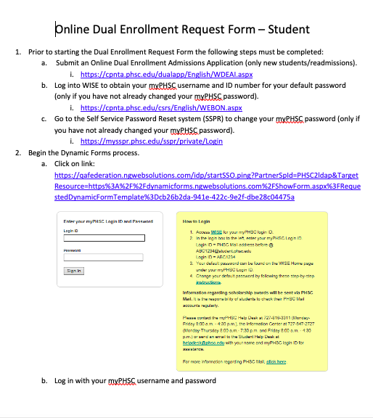
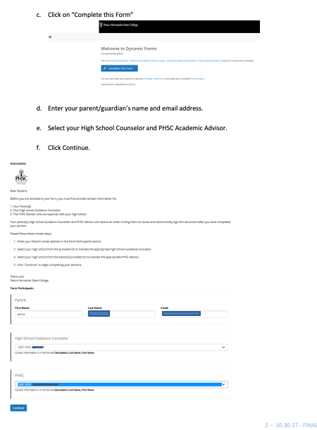
Dynamic Form Process
Notes:
Mer

Slide 32
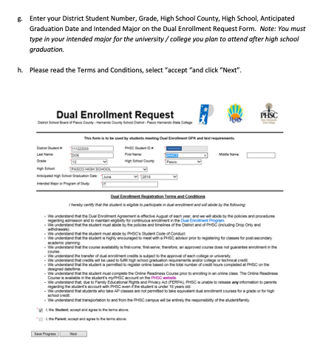
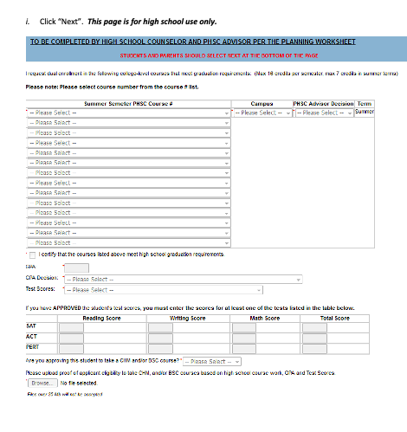
Dynamic Form Process
Notes:
Mer

Slide 33
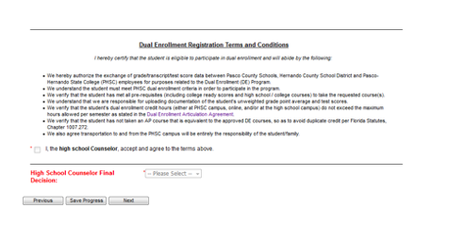
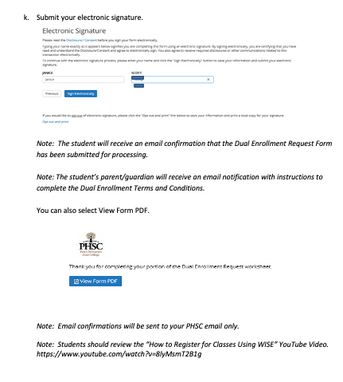
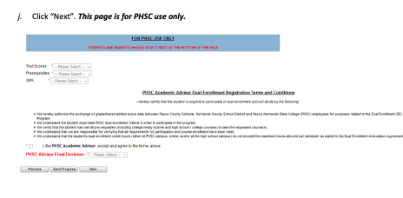
Dynamic Form Process
Notes:
Mer

Slide 34
Questions
Please email your 2025-2026 school counselor with any questions.
  9th grade: kleonard@pasco.k12.fl.us
  10th grade: mhagiemc@pasco.k12.fl.us
  11th grade: mward@pasco.k12.fl.us
  12th grade: ccaminer@pasco.k12.fl.us
  PHSC Advisor: Scott Bruce bruces@phsc.edu

