Slide 1
Grad Bash 2024

Slide 2
Grad Bash- 4/19/24
You will need to be on campus at 2:00pm for check-in
There is a strict dress code
You will need to picked up from campus as soon as we arrive back on 4/20/24- Usually around 3:30am
Ensure that your ride is here promptly at 3:30am

Slide 3
Dress Code
There is a strict dress code- White handout
If you are not in the correct dress code we will not be waiting for you. Come dressed correctly.
Important Info:
No school logos
No jerseys
No tank tops/sleeveless shirts/clothing that exposes excessive portions of skin
No clothing with obscene/inappropriate language or graphics
No clothing that is too tight or exposes undergarments
No bags larger than 8X5
Notes:
-If you are not in the correct dress code you will be sent home to change and you need to arrive back here asap before the bus leaves. We WILL NOT WAIT FOR YOU! Tickets are nonrefundable so if you miss for a dress code issue that is one way to lose $160.
-It is not us that is being strict it is UNIVERSAL. They give us the dress code and they will not allow you into the park.
-No crop tops/halter tops, biker shorts, spandex, leggings are okay, running shorts are in terms of like nike shorts
-Spandex Body Suits will NOT BE PERMITTED

Slide 4
Notes:
-If you are not in the correct dress code you will be sent home to change and you need to arrive back here asap before the bus leaves. We WILL NOT WAIT FOR YOU! Tickets are nonrefundable so if you miss for a dress code issue that is one way to lose $160.
-It is not us that is being strict it is UNIVERSAL. They give us the dress code and they will not allow you into the park.
-No crop tops/halter tops, biker shorts, spandex, leggings are okay, running shorts are in terms of like nike shorts
-Spandex Body Suits will NOT BE PERMITTED

Slide 5
Tickets
THERE ARE NO REFUNDS
There are a limited number of tickets (300)
Permission slips are required- return to Mrs. Minor in the media center or room 4-210
If you are not sure if your permission slip was turned in you can check with Mrs. Adley and Mrs. Minor after the meeting.

Slide 6
Buses/Groups
Buses will be assigned by administration and Corporal
You will get to pick a maximum of 10 per group (if there is more than 10 students signed up for a group, the remaining students will be moved to a new group. If there are spots not taken up people will be assigned the empty spots)
You can sign up at the end of the meeting!

Slide 7
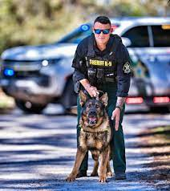
Rules/Expectations
Prohibited items include:
Vapes
Knives/Weapons
Drugs
Paraphernalia
Alcohol
Glass of any kind
Open water bottles (no outside food/drinks)
Notes:
-You WILL BE CHECKED COMING INTO CHECK IN AND BEFORE LEAVING to get on the bus.
-If you are found with anything there will be concequences.

Slide 8
Wristbands
Students will be issued a yellow wristband when they have cleared Corporal’s check and check in.
The wristband is REQUIRED and is your responsibility.
Wristbands are required AT ALL TIMES at Grad Bash.
Notes:
-Wristbands will go on you at check in. You can not take them off they are required to be on the bus and to get you into the park and while you are in the park.
-If I was you I would take a picture of your wristband and the code that is on it for just incase
-Same thing with your tickets when you get those from your chaperones. They are paper tickets that you will need to scan when we go in. Take a picture of the code on the back so incase you lose it you have that picture and hopefully they will still let you in. No Promises! Just don’t loose them ☺

Slide 9
Arrival/Departure- YELLOW
Our group is assigned to the YELLOW lot
Schools with Yellow wristbands will depart from the World Expo area using the exits located next to the Men in Black attraction.
Please make sure that you and your group arrive at the departure area to check in with your chaperone by 1:30am. Your chaperone will designate your meeting location near the Men in Black ride.
There will be color coded exit areas and signs to help you locate the correct location
Notes:
-We will arrive into the park from this location and exit the park from this location.
-Make sure you all know what bus you are on, Chaperones will give/have bus numbers. We don’t want you on the wrong bus

Slide 10
Q & A
Any questions?
Raise your hand and we will call on you ☺
We will also post this and the outlines for the Grad Bash Rules on your class canvas page
Notes:
-We will arrive into the park from this location and exit the park from this location.
-Make sure you all know what bus you are on, Chaperones will give/have bus numbers. We don’t want you on the wrong bus

Slide 11
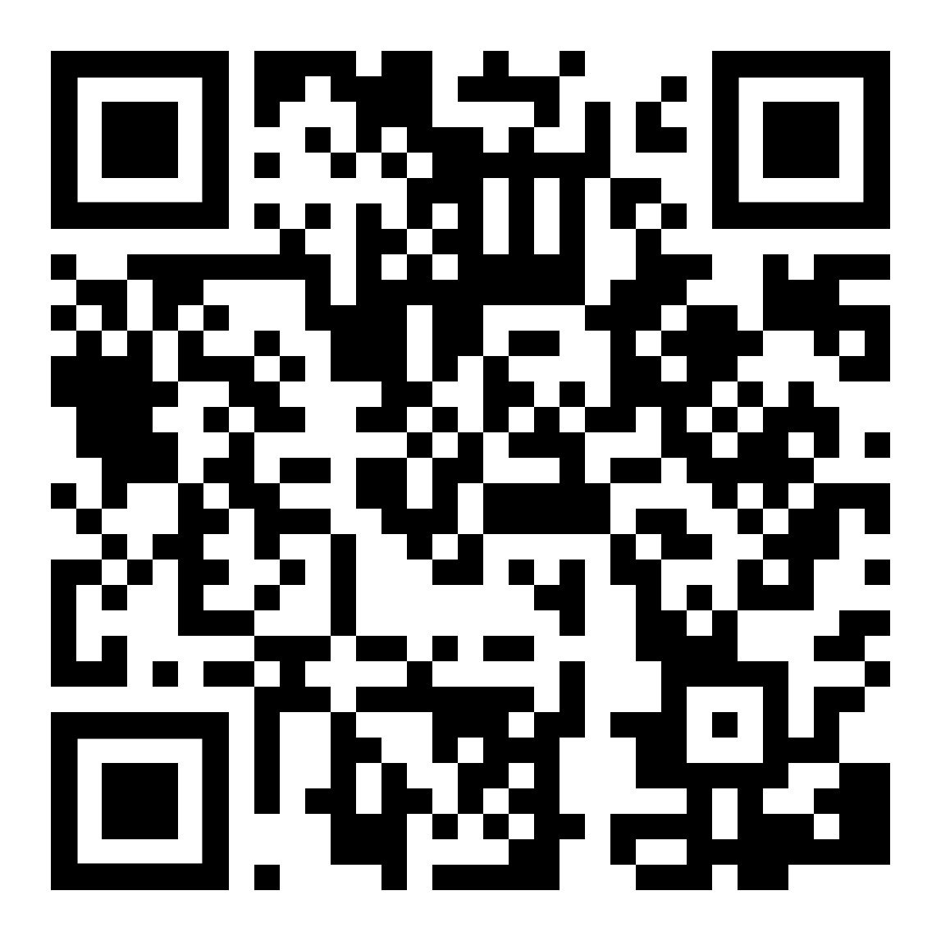
Sign In Using the QR code
Notes:
HAVE TO DO THIS!

