Slide 1
Cypress Creek High School
9th grade Parent University
Mrs. Caminero
9th Grade
School counselor
Mrs. Gricoski
9th Grade
Assistant Principal

Slide 2
Welcome to coyote nation!

Slide 3
Meet your coyote team!
9th Grade
Assistant Principal
9th Grade
SCHOOL
COUNSELOR
PRINCIPAL
Carin
Hetzler-Nettles
Donna
Gricoski
Cassie
Caminero

Slide 4
SUPPORT STAFF
Cassie Adley
Allison Heck
Sarah Franco
Andrea Latimer-Chaney
Carol Donald
School Social Worker
Student Services Secretary
College & Career Specialist
School Nurse
School Psychologist

Slide 5
Stay Connected!
Cypress Creek High School Website: https://cchs.pasco.k12.fl.us
General information
Class of 2026 page: https://cchs.pasco.k12.fl.us/class-of-2026/
Students can make an appointment with counselor (student requests only)
Calendars (activity and testing)
MyStudent (grades, attendance)
MyLearning (student Class of 2026 page)
NAVIANCE (COLLEGE/Career planning)./
Howler Hub newsletter – For parents AND students
Ed. 1 https://www.smore.com/pn3kv
CCHS Facebook: https://www.facebook.com/CypressCreekCoyotes/
CCHS Twitter: @thecoyoteway
CCHS Counselor Twitter: @counselorshowl

Slide 7
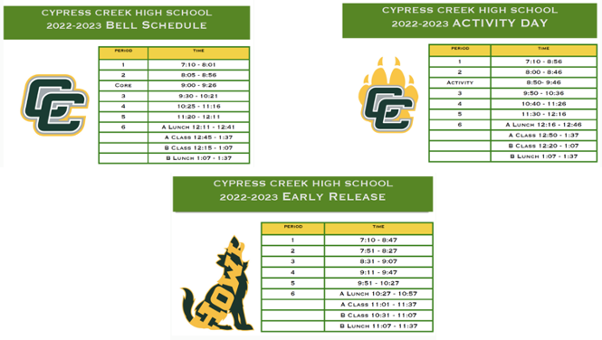
BELL SCHEDULES

Slide 8
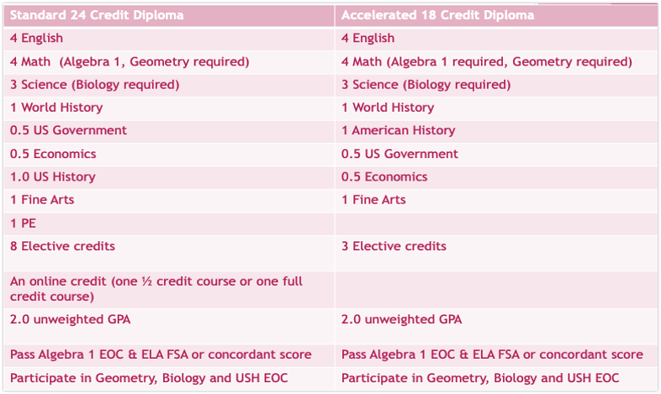

Slide 9
TESTING
It is important for your student to be present and try their best on the state exams
A passing score on the Algebra 1 EOC and Reading FSA ELA are required to graduate
Algebra 1 EOC: Taken end of year during 9th Grade
Reading FSA ELA: Taken end of year during 10th grade
Concordant scores can be used on PSAT, SAT, and ACT
Algebra 1, Biology, Geometry, US History EOCs – exam counts as 30% of student’s final yearlong grade
Families are encouraged to apply for Free/Reduced Lunch (if approved, testing waivers may be applied)

Slide 10
PARENT TEACHER CONFERENCES
Parent/student should reach out to the teacher directly to try to rectify concerns prior to contacting Carol Donald, our Student Services Secretary.
Meetings can be scheduled through Ms. Donald in the Student Services Office at 813-346-4400
Students are encouraged to attend.
PTC and IEP/504 meetings will be primarily held virtually

Slide 11
Schedule changes will only be made if:
The student has already taken the course
A prerequisite is required for a course on your student’s schedule
No schedule changes if a student wants a different lunch

Slide 12
ACADEMIC HELP
Academic lunch with teacher is available during lunch period
Contact the individual teacher for individual support after school
Counselor is available on the stage during both lunches
Coyote Core
NHS Tutoring after school

Slide 13
CCHS WEBSITE
www.cchs.pasco.k12.fl.us
Attendance
How to report an absence
Athletics Info
Car Loop Instructions
Volunteer Application
Payment of School Fees

Slide 14
Activities scheduled
for 22-23
After School Club Days
Pep Rallys
Grade Level Meetings
Athletics
Homecoming & Spring Howl
Powderpuff & Homecoming Dance
Dress-up Days

Slide 15
College/Career specialist
Mrs. adley (Office in the media)
SAT/ACT Testing
College Application Process
Scholarships
Financial Aid
Military Recruitment
Careers and Trades
Resume and Interview Skills
Post-Graduation Planning

Slide 16
Options after
graduation
4-YEAR UNIVERSITY BACHELORS DEGREE (USF, UF, FSU)
2+2 PLAN=2 YEARS AT PHSC (AA)/2 YEARS AT A UNIVERSITY
ASSOCIATE OF SCIENCE (2 YEARS + ENTER WORKFORCE)
TRADE OR TECHNICAL COLLEGE/APPRENTICESHIP
ENTER THE WORKFORCE
ENLIST IN THE MILITARY

Slide 17
Bright futures
Florida Academic Scholars
Florida Medallion Scholars
Gold Seal
•3.0 weighted GPA in non-elective courses
•3.5 unweighted GPA in vocational courses (3 credits in vocational program)
•4 English/4 Math/3 Nat. Science/3 Social Science/HOPE
•Qualifying scores on ACT, SAT, or PERT
•30 community service hours or work-based hours
•$39-$48 per credit hour (depending on program)
•Up to 72 college credit hours in a vocational program of study
•3.5 weighted GPA in core classes (plus two years foreign language)
•1330 SAT or 29 ACT
•100 community service hours or work-based hours
•100% tuition and fees paid to a Florida public university or college
•Renewable for four years (3.0 GPA/minimum 12 hours per semester)
•3.0 weighted GPA in core classes (plus two years foreign language)
•1210 SAT or 25 ACT
•75 community service hours or work-based hours
•75% tuition and fees paid to a Florida public university or college (100% paid for state/community college)
•Renewable for four years (2.75 GPA and a minimum 12 hours per semester)

Slide 18
Service Opportunities
Pasco County Library
Gulf Hospice Thrift Shoppe
Pasco County Animal Shelter
Florida Hospital
Habitat for Humanity
Big Brothers/Big Sisters
School events
Feed Tampa Bay
WCAA
Community Events

Slide 19
University Considerations
Rigor of coursework: AP/Dual Enrollment, additional math/science courses, most difficult classes offered CCHS
Two years/units of the same foreign language
GPA (weighted core 9th-11th grade)
SAT or ACT scores (all Florida public universities)
Holistic Review: Essay, Service, Leadership, Extracurricular

Slide 20
College/Career
2026 Remind
TEXT @adleycc26 TO 81010

Slide 21
SAVE THE DATE!
Open House:
“Meet the Teachers”
August 5th
8am-11am
12pm-3pm

Slide 22
QUESTIONS?

